Slide 1
Javascript utility
Reads each file and builds basic stats on the fly
Counts, Min, Max, Sum, Sum of Squares
From this we can calculate Mean, Variance, Std Deviation, Std Error, and Confidence intervals for the mean.
Builds a complex JSON object dynamically
Calculates groups by Year, Year/Month, Year/Month/Day, Year/Month/Weekday, Year/Day, Year/Weekday, Year/Week, Year/Week/Weekday, Month, Month/Day, Month/Weekday, Week, Week/Weekday, Weekday, Weekday/Hour, Day (of year), Day (of month), Hour
Does NOT group by route because there are a ton of individual routes to track.

Slide 2
Javascript objects
Stats object: count, min, max, sum, sum of squares
FltStats object: label, flights, numTailNA, actualElapsed (stats), arrivalDelay (stats), departureDelay (stats), distance (stats), schedDuration (stats), numCancelled, numDiverted, carrierDelay (stats), weatherDelay (stats), NASDelay (stats), securityDelay (stats), lateAC (stats), numLateTakeoff, numLateArrive, numEarlyTakeoff, numEarlyArrive
Those fields marked “(stats)” are Stats objects, so they build those basic statistics automatically
FltRec object: Maps the fields from the data file to an object, plus performs conversions and adds fields.
HHMM converted to hours-only and total minutes, NA converted to 0
Week of the year is calculated, as is day of the year, so we can use those for statistics and grouping

Slide 3
This gives us a multi-root hierarchical tree of nested basic stats from which we can query and build visualizations
The code saves this big hierarchical structure as a JSON file so it can be loaded instead of re-processing the raw data files again.
The main root node of the tree we’ll call “Flight”
The code read all 22 files and 123 million+ records in just over 4 hours on my machine.

Slide 4
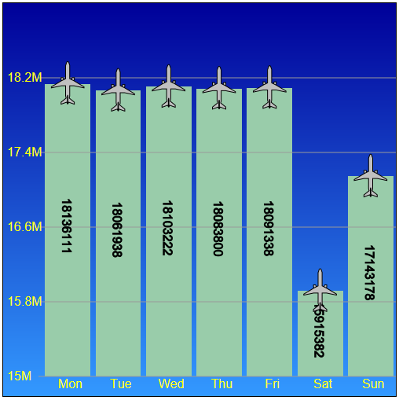
Question #3 – How many flights per day of week?
Data:
Flight.byWeekday.total.flights
Results:
Saturdays had the least # of flights at 15,915,382
Mondays had the most at 18,136,111
Sum of all counts = 123,534,969
Which matches the total record count for all 22 files
So we know the object does contain info for all the records

Slide 5
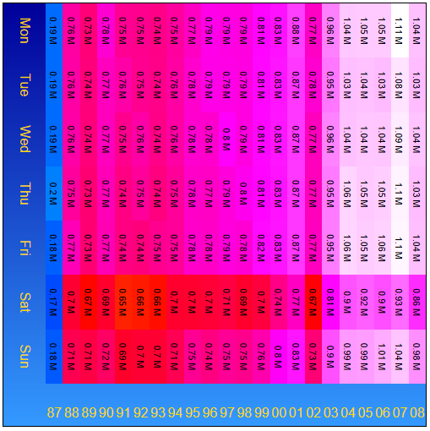
Question #4 – For each year, how many flights per day of week?
Data:
Flight.byYear[year].byWeekday[weekday].total.flights
Results:
1987 contained data for only Oct-Dec, so that’s why the numbers are so low.
We see the count increasing as the years increase
We see the low numbers for Saturday
We also see 2002 was drastically different due to 9/11
2007 had the most flights, with Mondays topping the counts
2008 dropped due to the economic decline

Slide 6
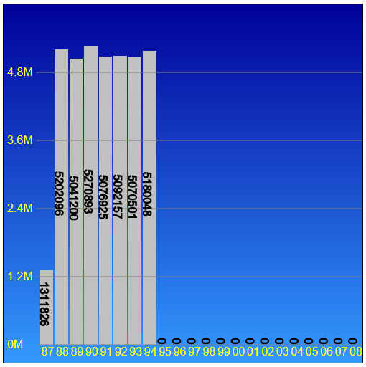
Question #5 – For each year, how many tail numbers are “NA”?
Data:
Flight.byYear.total.numTailNA
Results:
Low count in 1987 because the file only covered Oct-Dec
All tail numbers reported from 1995 on

Slide 7
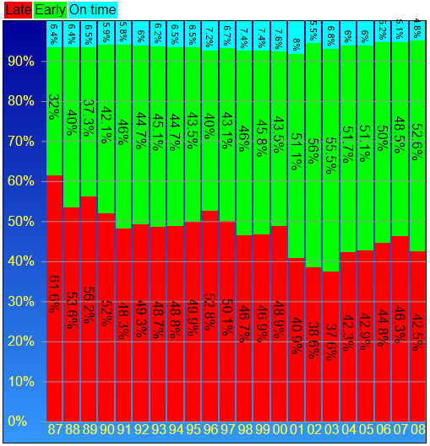
Question #6 – Which year had the greatest proportion of late flights?
Data:
Flight.byYear.total.numLateArrive / Flight.byYear.total.flights
Flight.byYear.total.numEarlyArrive / Flight.byYear.total.flights
Flight.byYear.total.flights – Flight.byYear.total.numEarlyArrive – Flight.byYear.total.numLateArrive
Results:
Even though 1987 only covered Oct-Dec, it had the greatest proportion of late flights than all other years (61.6%)
2003 had the smallest proportion of late flights (37.6%) and the greatest proportion of early arrivals (55.5%)
2001 had the greatest proportion of on-time flights (8%)

Slide 8
Question 7
Question 7 is vaguely worded, and can be interpreted a number of ways
Since we have the data to support it, let’s look at it in a variety of ways
7A – Arrival delay versus day of year
7B – Departure delay versus day of year
7C – Arrival delay versus day of month
7D – Departure delay versus day of month
7E – Arrival delay versus day of week
7F – Departure delay versus day of week
7G – Arrival delay versus hour of day
7H – Departure delay versus hour of day

Slide 9
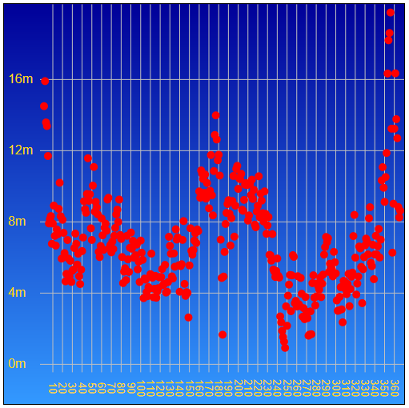
7A – Arrival Delay vs. Day of Year
Data:
Mean(Flight.byDay.total.arrivalDelay)
Confidence intervals are plotted as well, but because there are millions of points, the CI are smaller than the dots
Results:
The winter holiday period has the greatest arrival delays, as does the peak of summer
Fall is a good time of year to travel

Slide 10
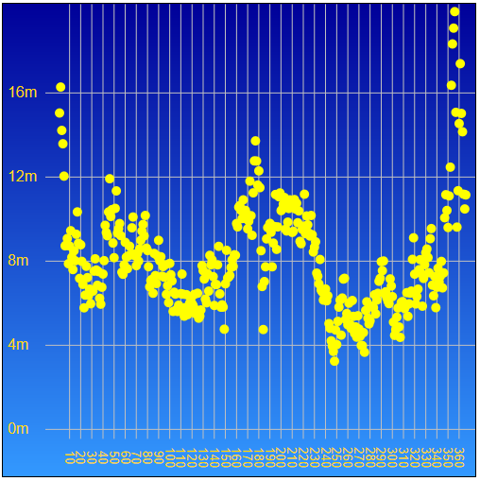
7B – Departure Delay vs. Day of Year
Data:
Mean(Flight.byDay.total.departureDelay)
Confidence intervals are plotted as well, but because there are millions of points, the CI are smaller than the dots
Results:
The winter holiday period has the greatest departure delays, as does the peak of summer
Fall is a good time of year to travel

Slide 11
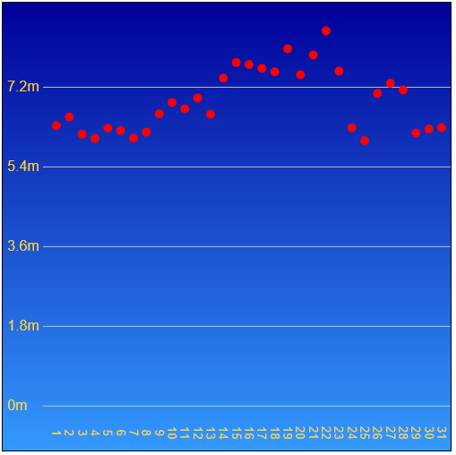
7C – Arrival Delay vs. Day of Month
Data:
Mean(Flight.byDate.total.arrivalDelay)
Confidence intervals are plotted as well, but because there are millions of points, the CI are smaller than the dots
Results:
The start and end of the months have lower delays.
Delays increase as the month progresses, peaking at the third week

Slide 12
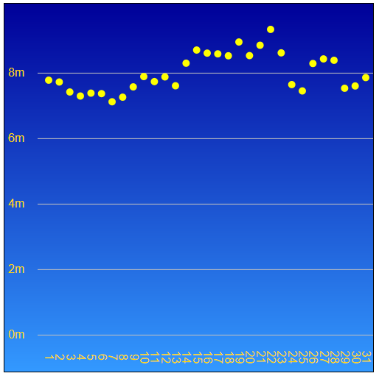
7D – Departure Delay vs. Day of Month
Data:
Mean(Flight.byDate.total.departureDelay)
Confidence intervals are plotted as well, but because there are millions of points, the CI are smaller than the dots
Results:
The end of the first week of the month appears to have lower departure delays.
Delays increase as the month progresses, peaking at the third week

Slide 13
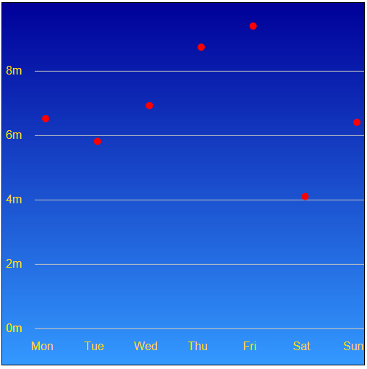
7E – Arrival Delay vs. Day of Week
Data:
Mean(Flight.byWeekday.total.arrivalDelay)
Confidence intervals are plotted as well, but because there are millions of points, the CI are smaller than the dots
Results:
Saturday has the lowest mean arrival delay (just over 4 minutes)
Delays increase as the week progresses
Friday has the worst average (over 9 minutes)

Slide 14
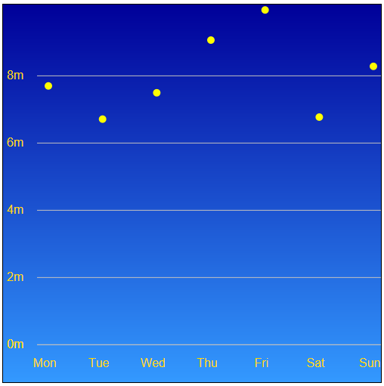
7F – Departure Delay vs. Day of Week
Data:
Mean(Flight.byWeekday.total.departureDelay)
Confidence intervals are plotted as well, but because there are millions of points, the CI are smaller than the dots
Results:
Tuesday has the lowest mean departure delay (about 6.5 minutes), with Saturday close behind
Delays increase as the week progresses
Friday has the worst average (almost 10 minutes)

Slide 15
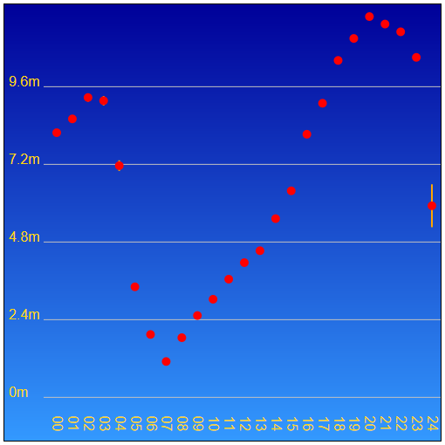
7G – Arrival Delay vs. Hour of Day
Data:
Mean(Flight.byHour.total.arrivalDelay)
Confidence intervals are plotted as well, and can be seen on some of the points
The large CI at 24 is due to the fact that a few midnight arrival times were reported as hour 24 instead of hour 00. Low count = large CI
Results:
7AM had the least average arrival delay (about 1 minute)
8PM had the worst average (almost 12 minutes)
Delays are high for night arrivals and “red-eyes”, drop for the morning commuters, and steadily increase as the day progresses

Slide 16
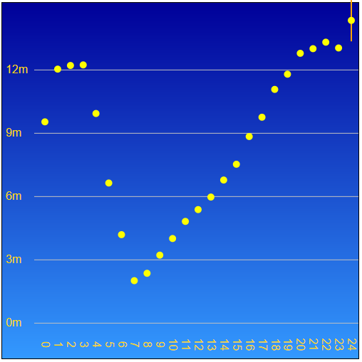
7H – Departure Delay vs. Hour of Day
Data:
Mean(Flight.byHour.total.departureDelay)
Confidence intervals are plotted as well, and can be seen on some of the points
The large CI at 24 is due to the fact that a few midnight departure times were reported as hour 24 instead of hour 00. Low count = large CI
Results:
7AM had the least average departure delay (about 2 minutes)
10PM had the consistently worst average (around 13 minutes)
Delays are high for night departures and “red-eyes”, drop for the morning commuters, and steadily increase as the day progresses

Slide 17
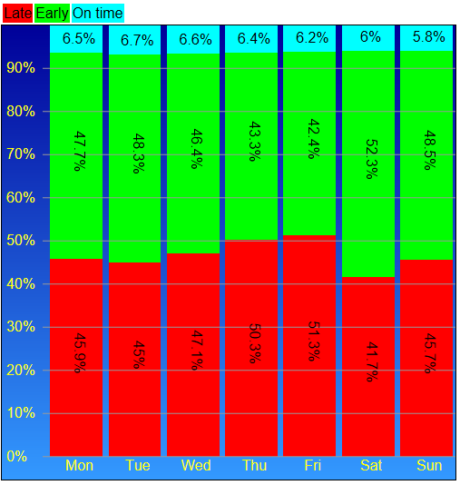
Question #8 – Which is the best day of the week to fly?
Data:
Flight.byWeekday.total.numLateArrive / Flight.byWeekday.total.flights
Flight.byWeekday.total.numEarlyArrive / Flight.byWeekday.total.flights
Flight.byWeekday.total.flights – Flight.byWeekday.total.numEarlyArrive – Flight.byWeekday.total.numLateArrive
Results:
Saturday had the least percentage of late arrivals (41.7%) and the most early arrivals (52.3%)
Friday had the highest percentage of late arrivals (51.3%) and lowest percentage of early arrivals (42.4%)
Tuesdays had the highest percentage of on-time arrivals (6.7%)

Slide 18
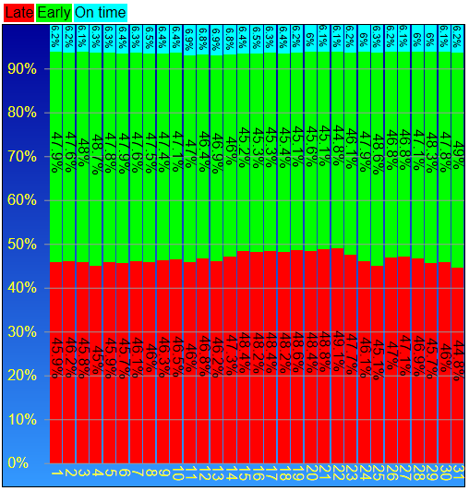
Question #9 – Which is the best day of the month to fly?
Data:
Flight.byDate.total.numLateArrive / Flight.byDate.total.flights
Flight.byDate.total.numEarlyArrive / Flight.byDate.total.flights
Flight.byDate.total.flights – Flight.byDate.total.numEarlyArrive – Flight.byDate.total.numLateArrive
Results:
The 31st of the month had the lowest percentage of late arrivals (44.8%) and highest percentage of early arrivals (49%)
The 13th of the month had the highest percentage of on-time arrivals (6.9%)
The 22nd of the month had the highest percentage of late arrivals (49.1%)
On-time arrivals are fairly consistent across the month

Slide 19
Question 10 – Are flights given more time to reach their destination in later years
This question could be looked at in different ways. Here, we look at it two ways:
10A – Scheduled flight duration with respect to distance travelled If this ratio increases over the years, then that is an indication that the scheduled time increased for the same distance
10B – Years may be too coarse, so we do the same per month and year combination

Slide 20
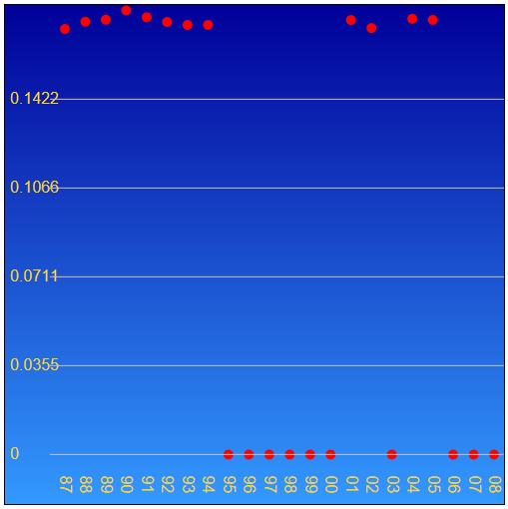
10A – Ratio of scheduled duration / distance per year
Data:
Mean(Flight.byYear.total.schedDuration) / Mean(Flight.byYear.total.distance)
Results:
It appears that may have been the case in the late 80s, but has been fairly consistent since.
There are large numbers of years with no data for this field

Slide 21
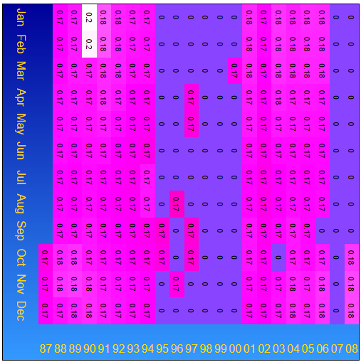
10B – Ratio of scheduled duration / distance per Month and Year
Data:
Mean(Flight.byYear[year].byMonth[month].total.schedDuration) / Mean(Flight.byYear[year].byMonth[month].total.distance)
Results:
It appears there was a large change in 1989-1990, but only in the winter months (Nov-Feb).
There are large numbers of years with no data for this field

Slide 22
Question 14 – How much does weather delay contribute to arrival delay?
While weather delay is interesting, there are several other factors that are included in the data set, so we look at this question two ways:
14A – Percentage of weather delay to total arrival delay – per month
14B – Contribution of all delay-related fields to total arrival delay – per month

Slide 23
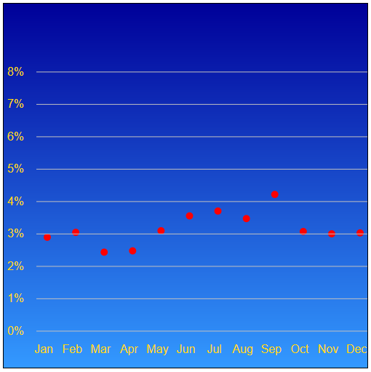
14A – Percentage of total arrival delay attributed to weather delay
Data:
Flight.byMonth.total.weatherDelay.sum) / Flight.byMonth.total.arrivalDelay.sum
Results:
Overall, weather accounts for only about 3% of the total arrival delay
September has the highest percentage (over 4%)
March and April have the lowest percentage (about 2.5%)

Slide 24
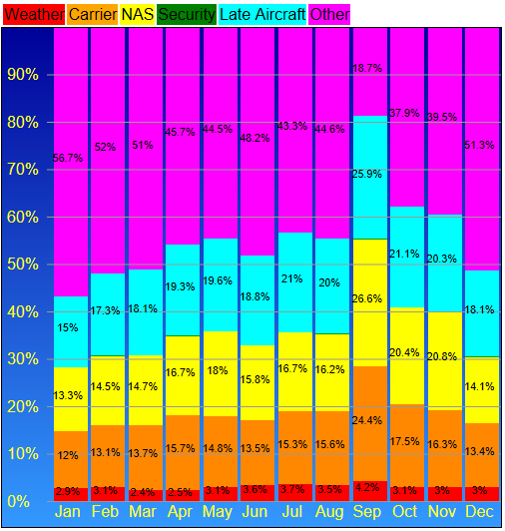
14B – Percentage of total arrival delay attributed to various delay categories
Data:
Flight.byMonth.total.weatherDelay.sum) / Flight.byMonth.total.arrivalDelay.sum
Similar for .carrierDelay, .NASdelay, .securityDelay, .lateAC, and then the remainder that was unaccounted for.
Results:
In addition to increased weather delays in September, Carrier delays, NAS delays, and Late aircraft all increase in September.
Security delays contribute just a fraction of a percent to delays

Slide 25
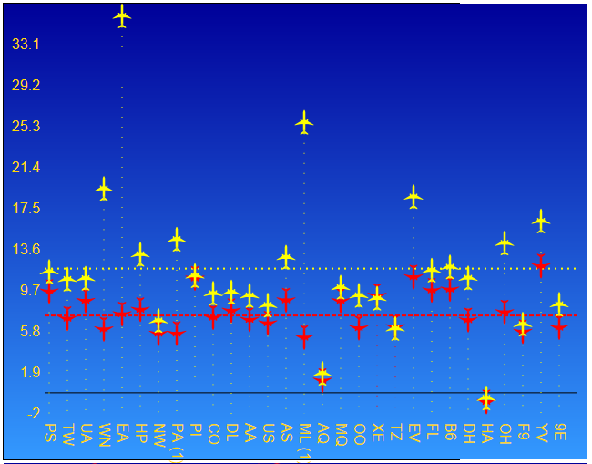
Average arrival and departure delays by carrier
Data:
Mean(Flight.byCarrier.total.arrivalDelay) [red]
Mean(Flight.byCarrier.total.departureDelay) [yellow]
Results:
Hawaiian Airlines (HA) had mean delays below 0!
Aloha Airlines (AQ) had mean delays of between 1-2 minutes
Mean arrival delay for all carriers was 7.6 minutes
Mean departure delay for all carriers was 10.45 minutes
Longest average departure delay was Eastern Airlines (EA) (over 35 minutes)

Slide 26
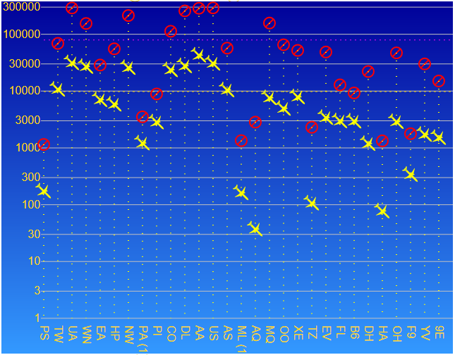
# Cancellations and diverts by carrier
Data:
Flight.byCarrier.total.numCancelled [red]
Flight.byCarrier.total.numDiverted [yellow]
Results:
Huge range in values. Had to use a logarithmic scale in the Y-axis
Aloha Airlines (AQ) had the least number of diverts (around 40), with American (AA) having the most (over 40,000)
Pacific Southwest Airlines (PS) had the least number of cancellations (1151), with United Airlines (UA) having the most (nearly 300,000)
Average number of diverts is just below 10,000
Average number of cancellations is over 90,000

Slide 27
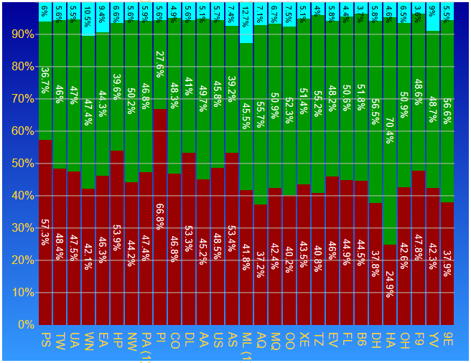
Arrival delays by carrier
Data:
Flight.byCarrier.total.numLateArrive / Flight.byCarrier.total.flights [red]
Flight.byCarrier.total.numEarlyArrive / Flight.byCarrier.total.flights [green]
On-time flights [cyan]
Results:
We see Hawaiian Airlines with only 24.9% late arrivals, and 70.4% early arrivals
Piedmont Aviation (PI) had the most late arrivals (66.8%)
Midway Airlines (ML(1)) had the best on-time record 12.7% and fairly evenly split late and early arrivals

Slide 28
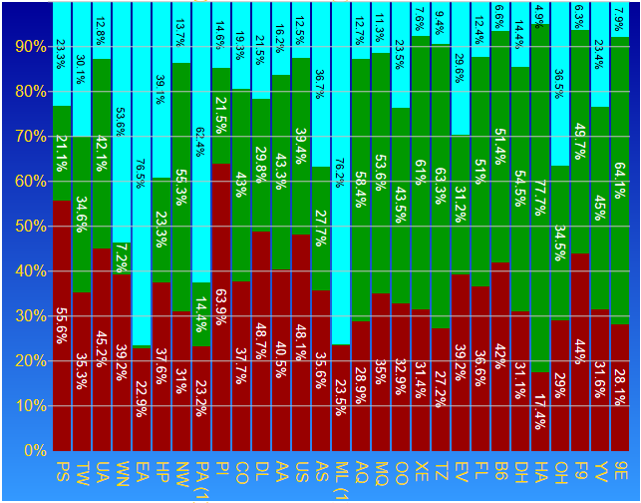
Departure delays by carrier
Data:
Flight.byCarrier.total.numLateDepart/ Flight.byCarrier.total.flights [red]
Flight.byCarrier.total.numEarlyDepart / Flight.byCarrier.total.flights [green]
On-time departures [cyan]
Results:
We see Hawaiian Airlines with only 17.4% late departures, and 77.7% early departures
Midway Airlines (ML(1)) and Eastern Airlines had the best on-time departure records (76.2% and 76.5%, respectively)
Piedmont Aviation (PI) had the most late departures (63.9%), which may have contributed to their late arrival numbers

